Slide 1
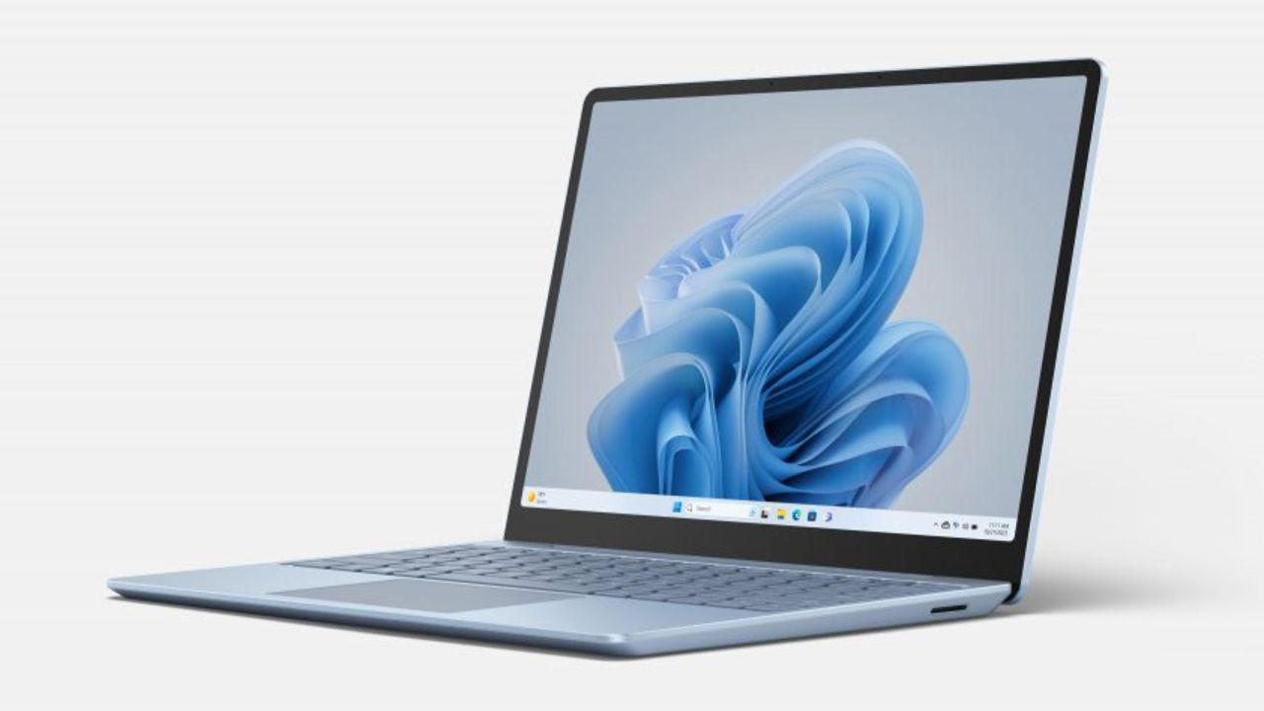
FlipKart Scrapping & Pushing into MySQL

Slide 2
INTRODUCTION
Project Overview
In this project, I undertook a comprehensive analysis of laptop data sourced from Flipkart, a leading e-commerce platform. The primary objective was to extract valuable insights into the pricing and discount patterns of various laptop models available online.
This project provides a practical example of how web scraping and data analysis can be used to derive actionable insights from e-commerce data. The findings can assist consumers in making informed purchasing decisions and offer valuable market insights for retailers.

Slide 3




Extracting data from Flipkart
Data Transformation using BeautifulSoup
Loading Data into MySQL
Data Analysis

Slide 4
Data Scraping: Leveraged web scraping techniques using Selenium and BeautifulSoup to gather detailed information about laptops from Flipkart, including model names, prices, and discount percentages.
Data Processing: Imported the scrapped data into structured DataFrame using pandas for efficient data manipulation and analysis
Key Objectives
Data Analysis: Conducted a thorough analysis to uncover trends and patterns in laptop pricing and discounts. This included generating visualizations to illustrate the distribution of discounts and price ranges across different laptop models.
Database Integration: Connected the DataFrame with a MySQL database for persistent storage and advanced querying capabilities.

Slide 5
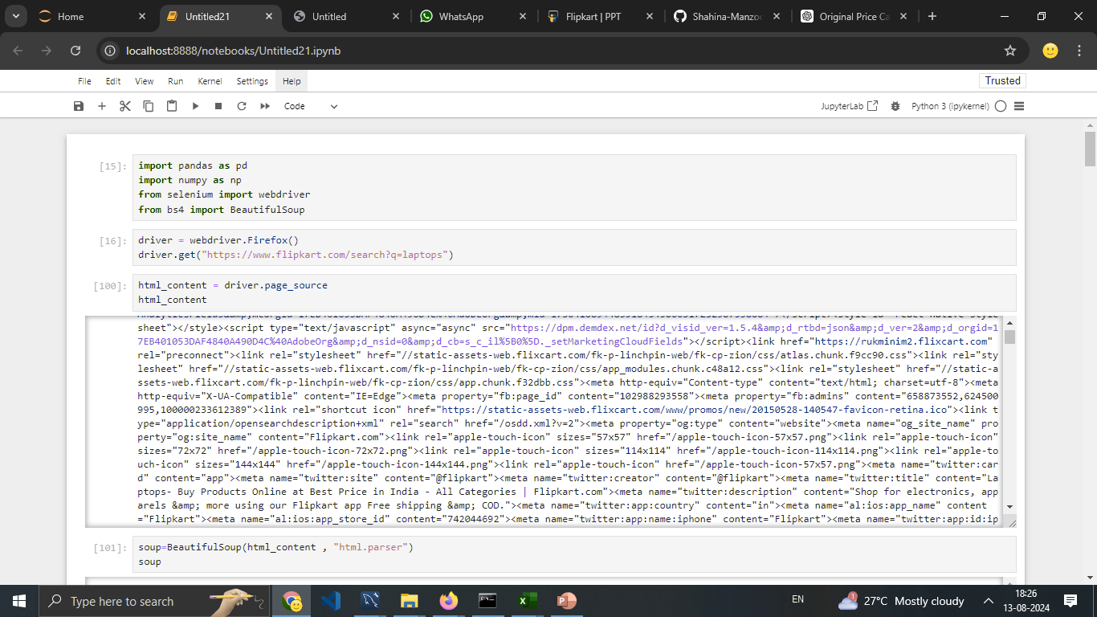
Navigate to the Web Page and Scrape Data

Slide 6

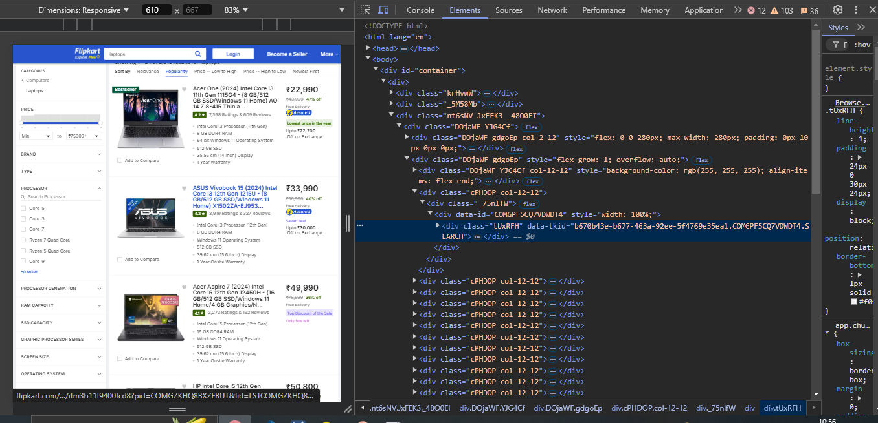

Slide 7
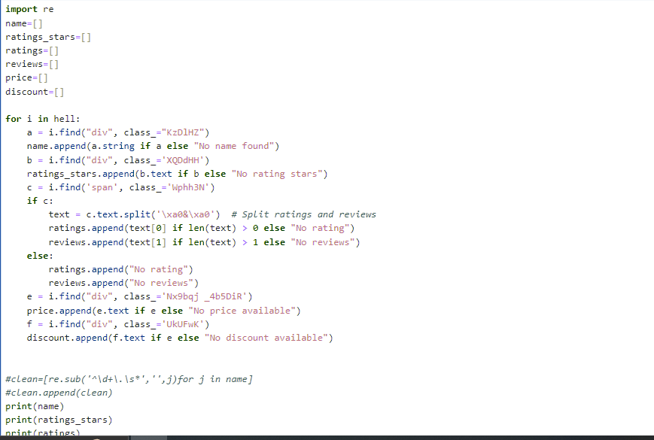

Parse HTML with BeautifulSoup: Using BeautifulSoup we can parse the HTML and extract the relevant data:

Slide 8
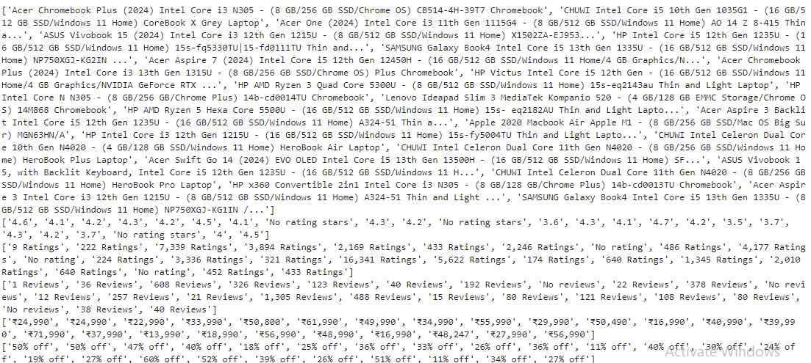
Result

Slide 9
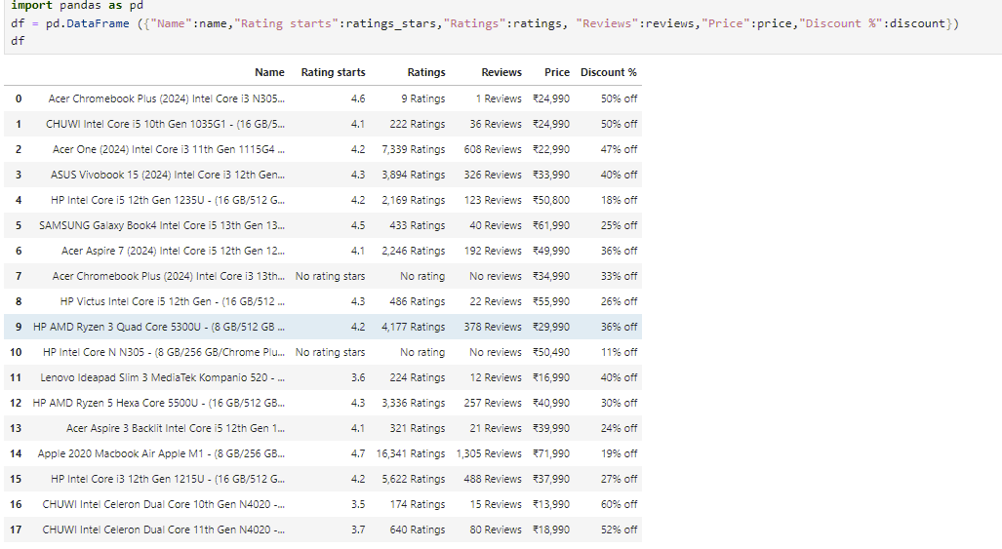
Preprocess and Save Data

Slide 10
Database Creation and Connection
Steps taken:
Created MySQL database for storing laptop data and establish a connection for data manipulation.
Verifying Database Creation.
Connect to the newly created MySQL database and prepare for data insertion.
Define table name for data insertion.
Appending data to the table

Slide 11
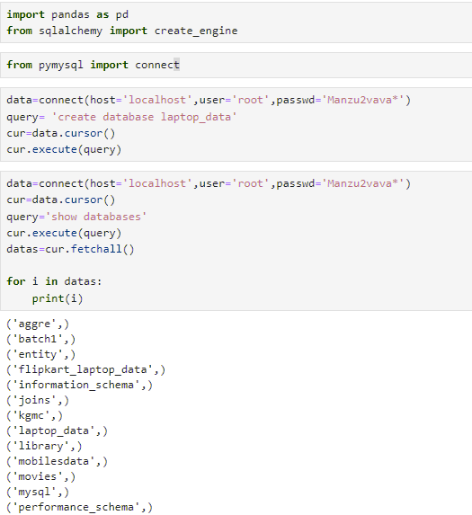
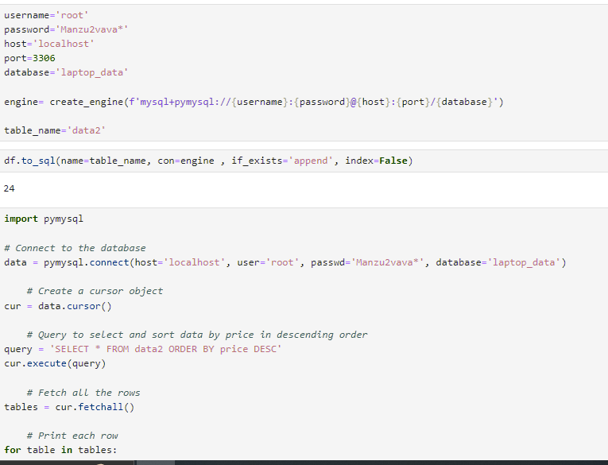

Slide 12
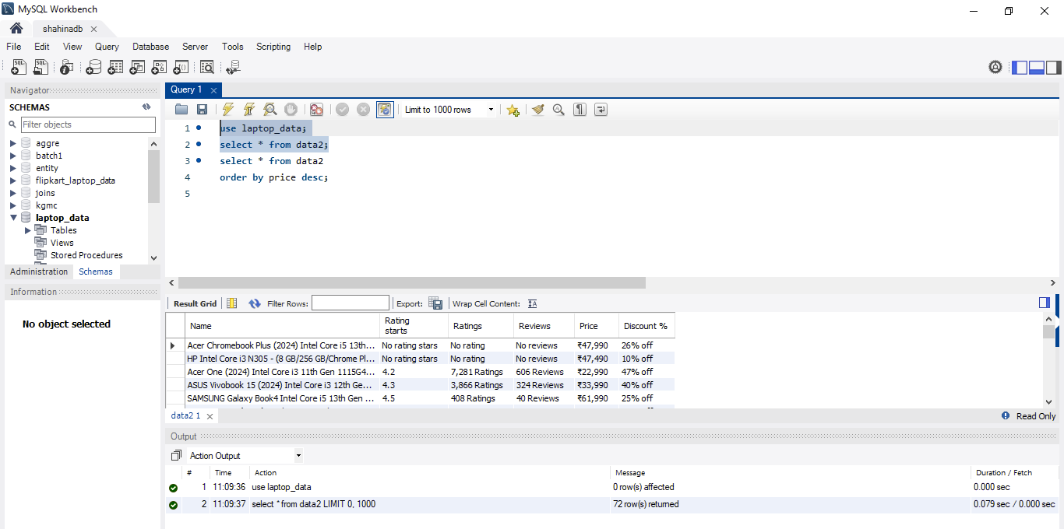
Verification of Data Integration: MySQL Database Validation

Slide 13
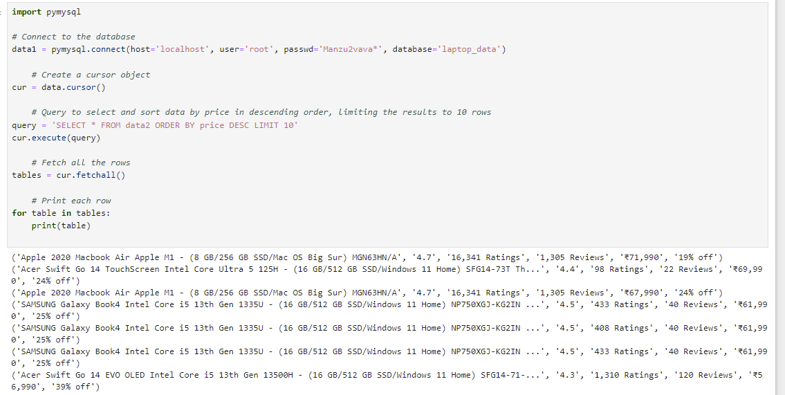
Retrieving and sorting laptop data from the MySQL database by price .

Slide 14
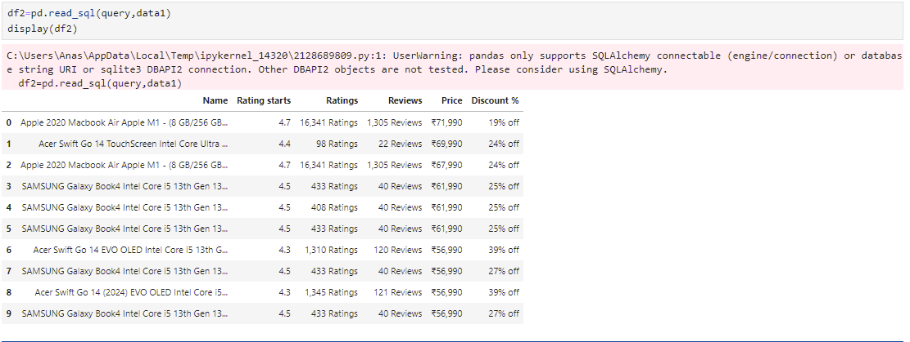
Result after retrieving and sorting laptop data

Slide 15
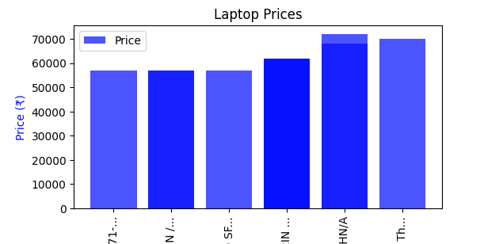
Analysis of Laptop Prices
Highest Price: ₹71,990 for the Apple 2020 Macbook Air Apple M1 - (8 GB/256 GB) with 16,341 Ratings and 1,305 Reviews.
Lowest Price: ₹56,990 for various Samsung Galaxy Book4 Intel Core i5 13th Gen models and
Acer Swift Go 14 (2024) EVO OLED models.

Slide 16
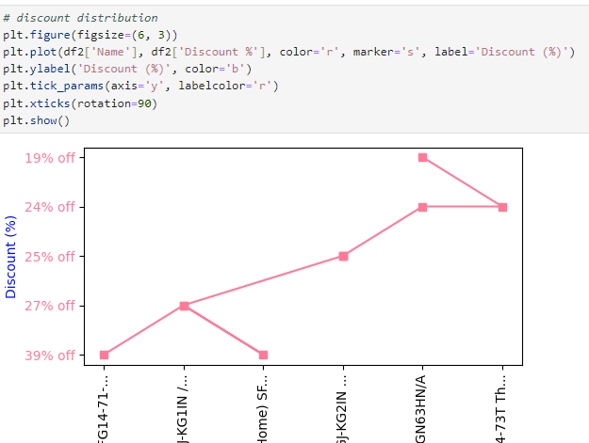
Discount Analysis:
Highest Discount: 39% off on Acer Swift Go 14 EVO OLED and Samsung Galaxy Book4 models.
Lowest Discount: 19% off on Apple 2020 Macbook Air.

Slide 17
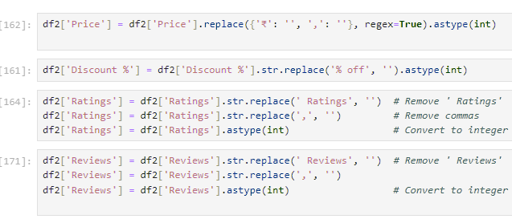
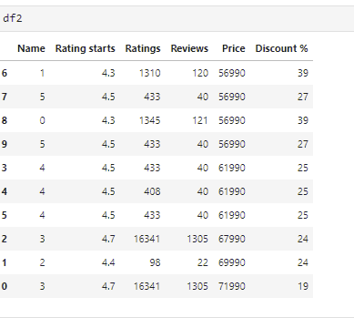
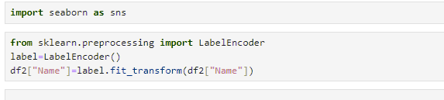
Correlation Analysis
Cleaning dataframe, df2 - Price, Discount %, Ratings, and Reviews columns in integer format, making them suitable for numerical analysis and correlation calculations.

Slide 18
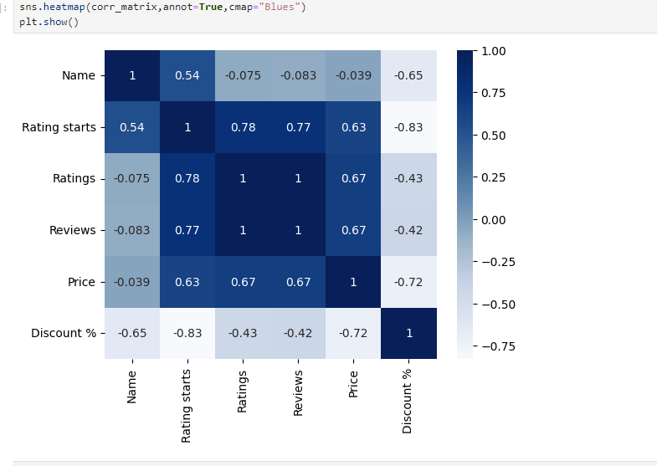
Heatmap for Correlation Matrix Analysis

Slide 19
Key Observations
High Positive Correlations:
Rating stars has a strong positive correlation with Ratings (0.778) and Reviews (0.773).
This suggests that higher ratings and more reviews are associated with a higher rating star.
Price has a moderate positive correlation with Rating starts (0.625), Ratings (0.667), and Reviews (0.667).
This implies that more expensive laptops tend to have better ratings and reviews, though the correlation is not
extremely strong.
High Negative Correlation:
Discount % has a strong negative correlation with Rating starts (-0.831), Ratings (-0.426), and Reviews (-0.422).
This suggests that higher discounts are associated with lower ratings and fewer reviews. This could imply that
laptops with high discounts might be less well-reviewed or have lower starting ratings.
Discount % also has a strong negative correlation with Price (-0.723). Higher discounts tend
to be associated with lower prices.

Slide 20
Conclusion
Ratings and Reviews are highly correlated, indicating that higher ratings often come with
more reviews.
Price and Ratings/Reviews have moderate positive correlations, suggesting that more expensive
laptops tend to have higher ratings and reviews.
Discount % is negatively correlated with Ratings, Reviews, and Price, implying that larger discounts
are often linked with lower ratings and prices.

Slide 21


